Slide 1
Short term energy load forecasting for commercial buildings
Department of Electronic & Electrical Engineering Faculty of Engineering Sciences
David Sal Supervisor: Dr Ryan Grammenos
Notes:
The banner on the title slide is larger than on the other slides and contains information about the department. Add your project title, name and supervisor name. When you put this PowerPoint file into slide show mode the slides will advance automatically every three seconds. For the actual poster you would need to set this to 30 seconds.

Slide 2

Problem statement
Datasets with energy load measurements in kWh taken every 30 mins.
2 separate buildings both located at IBM Hursley Site, UK:
Goal: Make accurate energy load forecasts for the day ahead with Mean Average Percentage Error (MAPE) of less than 5%.
Hursley House (HH) | D East Block (DE)
“Low tech” building Natural ventillation only Heating: wet water system | “High tech” building Mechanical ventillation with HVAC plant
Notes:
The banner on subsequent slides should contain your name, project title and affiliation. You need to change this information in the “Slide Master” (View -> Slide Master). The total number of slides needs to be changed in the “Slide Master” too.

Slide 3
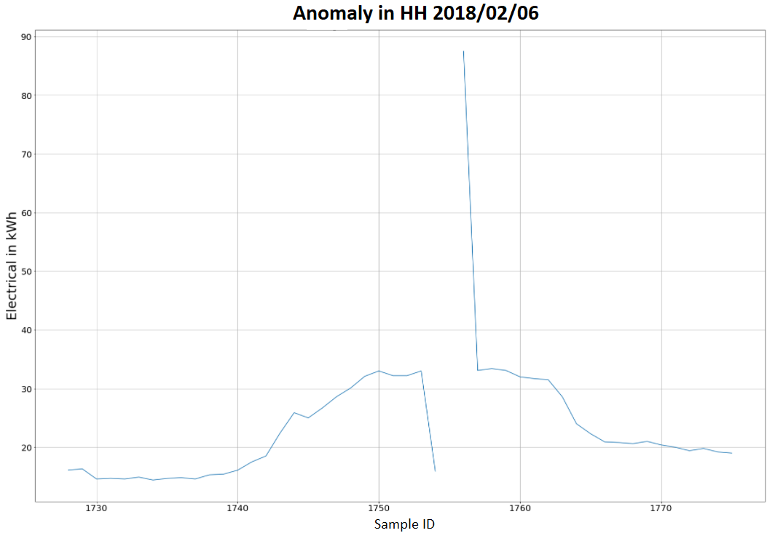
Phase 1: Data preprocessing
Identified outliers using statistics (z-score)
When visualizing it was identified that outliers in both buildings follow patterns:
Low value-missing value-outlier
(shown on the figure on the right)
Multiple missing values-outlier
Low value - high value
For all outliers, apportioning the sum across the pattern proved to be a realistic solution that preserved information.
Notes:
Potential improvement: visually connect the images with the text. Be consistent with the use of bullet points. This and the following slides don’t use bullet points, while the previous one does.

Slide 4
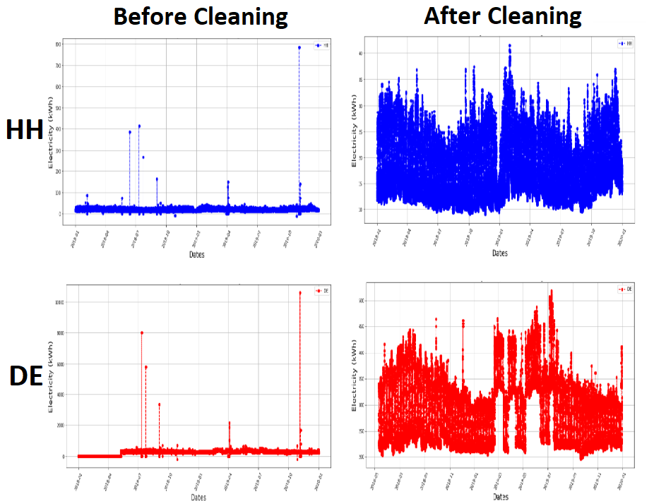
Data cleaning and enrichment
Developed cleaning algorithm that cleans the outlier patterns.
Manually cleaned remaining outliers in the dataset.
Enriched dataset with exogenous factors that influence energy load:
Temperature
Humidity
Feels like temperature (calculated using multiple exogenous factors)
Notes:
Make sure you are not covering up the page number. The font size of the axis labels is too small in this example.

Slide 5
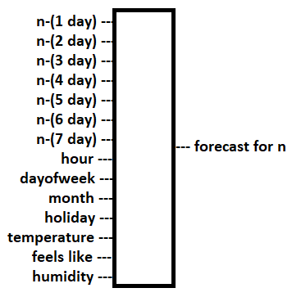
Phase 2: Forecasting using the dataset
Feature engineering:
Created hour, dayofweek, month and holiday features-
Different combination of past values. Using the specific hour from the previous 7 days proved to be the best
Model selection:
Split data 60-20-20 (train-selection-test)
Finetuned parameters for multiple machine learning models using 5 fold cross validation on 60% of data
Selected best model using 20% of data
Evaluated model on 20% test data
Notes:
Highlight the important information in this table. Not all values are necessary. The reader would not know which ones to focus on.

Slide 6
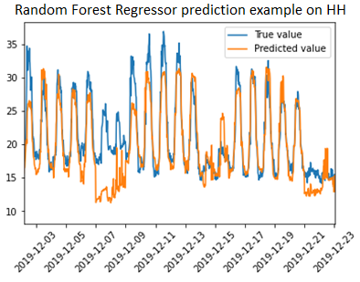
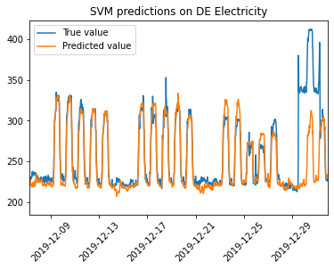
Results
Random forest (RF) on HH – 5.3% MAPE score
Support Vector Machine (SVM) on DE – 2.87% MAPE score
The two figures on the right depict timeframes where the models performed the worst. The RF model performed poorly. After extensive analysis I concluded that the inaccuracies are mostly due to random behaviour of the HH building that cannot be explained by the dataset. The randomness is likely due to the low tech profile of the building.
The performance of the SVM model on DE is satisfactory. It only fails to predict random spikes during the day and has small mispredictions at times. It managed to predict the Christmas week (3rd) rather accurately but failed at new years week.
To gain a deeper understanding of the models SHAP interpretability technique was applied (for further information please see Appendix provided as a printout).

Slide 7
Conclusion and future work
Summary:
The large dataset consisting of 10000s of energy load measurements was successfully cleaned whilst preserving as much information as possible.
Feature engineering, model selection and hyperparameter tuning was performed to produce accurate predictions.
The performance of the model on unseen data was satisfactory for the DE building whilst for the HH model there is room for improvement.
Future work:
Acquire dataset for 2020-2022 and evaluate the proposed models.
Use additional data to improve the forecasting accuracy.
Acquire occupancy dataset as it is a further exogenous factor that might explain randomness HH model.
Notes:
Three slides with results is the maximum. In this example you would need more explanation: what do we see in this graph?

